Slide 1
I-JEPA Reimplementation
Final Presentation

Slide 2
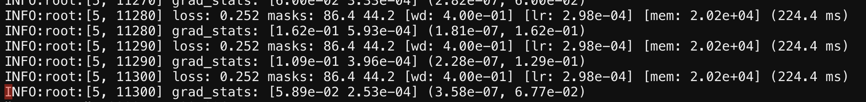
JEPA From Scratch
Rectangular Masks
Elliptical Mask

Slide 3
JEPA From Scratch
Downstream tasks from checkpoints:
Image classification on CIFAR100
Image Config - 32x32
Trained for 5 epochs -> Accuracy yielded 15%
Image classification on Imagenet-1k
Image Config - 64x64
Trained for 5 epochs -> Accuracy yielded 20%
Classification task performed on Imagenet-1k using a simple ViT
Accuracy ~ 28%

Slide 4
JEPA From Scratch
Challenges:
Choosing the right masking ratio is non-trivial; too few masks make the task easy, while too many masks reduce context.
Small datasets may not allow the model to sufficiently explore various masking patterns.
Augmentation techniques, such as random cropping or resizing, may interfere with masking strategies.
Pretraining on simple datasets might not transfer well to complex downstream tasks.
Original Dataset being very large ~150 to 200GB.

Slide 5
Enhancements
I-JEPA with simpler CNN based architectures
I-JEPA written in Tensorflow-Keras
Modular and Extensible Code

Slide 6
CIFAR-10
Dataset

Slide 7
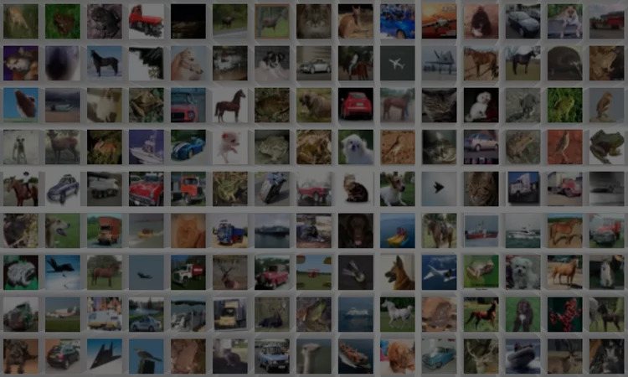
32x32x3

Slide 8
Block Generation
Generating context and target blocks

Slide 9
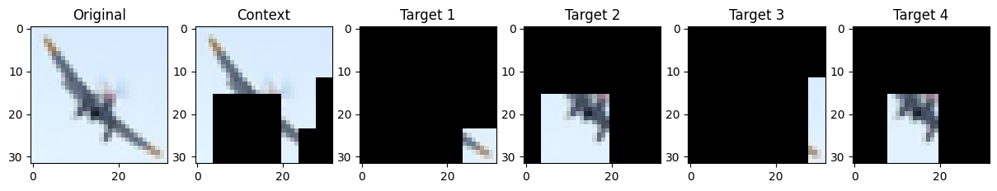

Slide 10
Experiments
Training with Random Weight Initialization
Transfer Learning: Imagenet weights
Transfer Learning: Imagenet weights with frozen encoder
I-JEPA Pretraining and linear probing (classification)
I-JEPA Pretraining, frozen encoder and linear probing (classification)

Slide 11
VGG16
Encoder

Slide 12
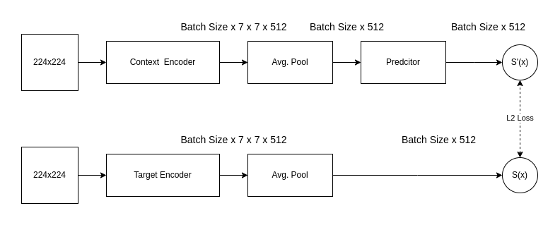
Architecture
Flatten
32x32x3
Target Coords
32x32x3
Flatten

Slide 13
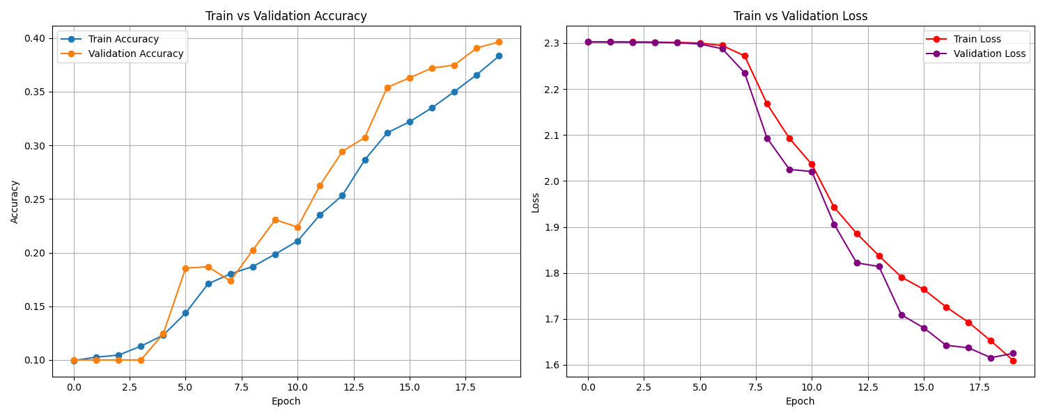
VGG16 trained from scratch

Slide 14
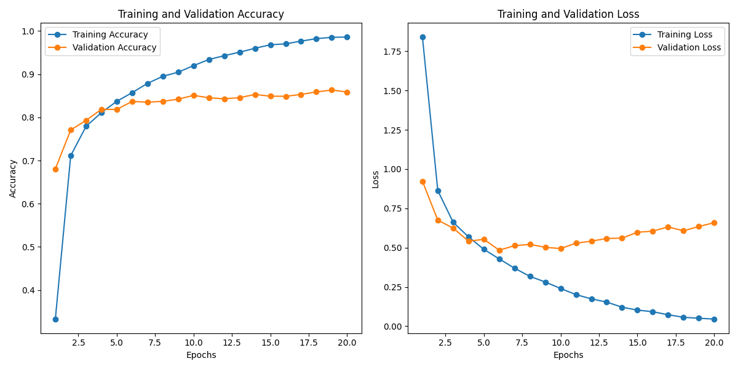
VGG16 w/ Imagenet Weights Fine Tuned

Slide 15
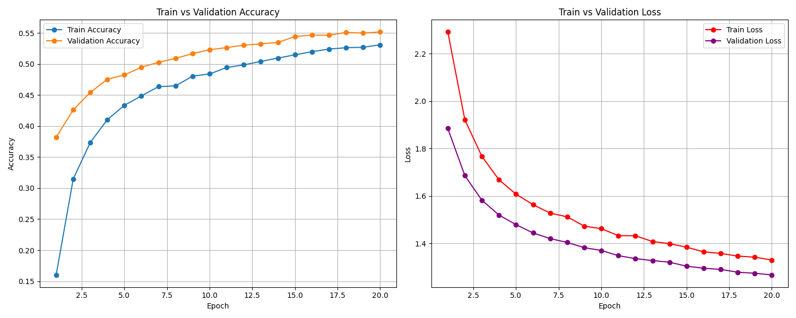
VGG16 w/ Imagenet weights - Frozen Encoder

Slide 16
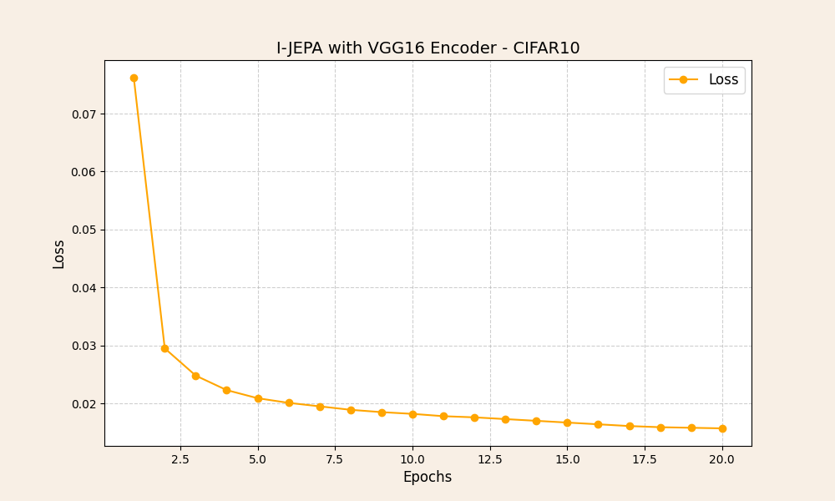
I-JEPA Pre-Training Log

Slide 17
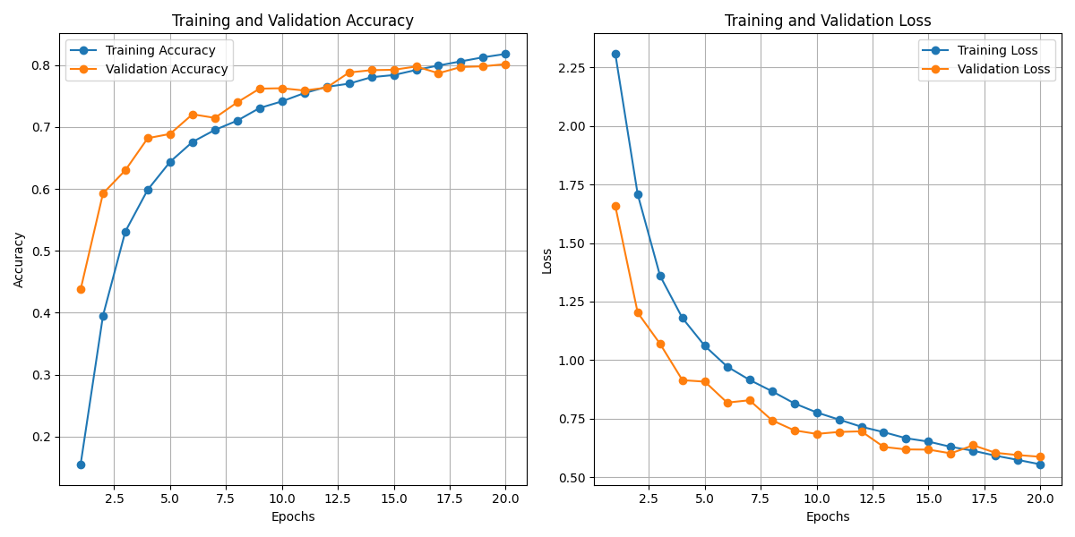
I-JEPA Pretrained Encoder

Slide 18
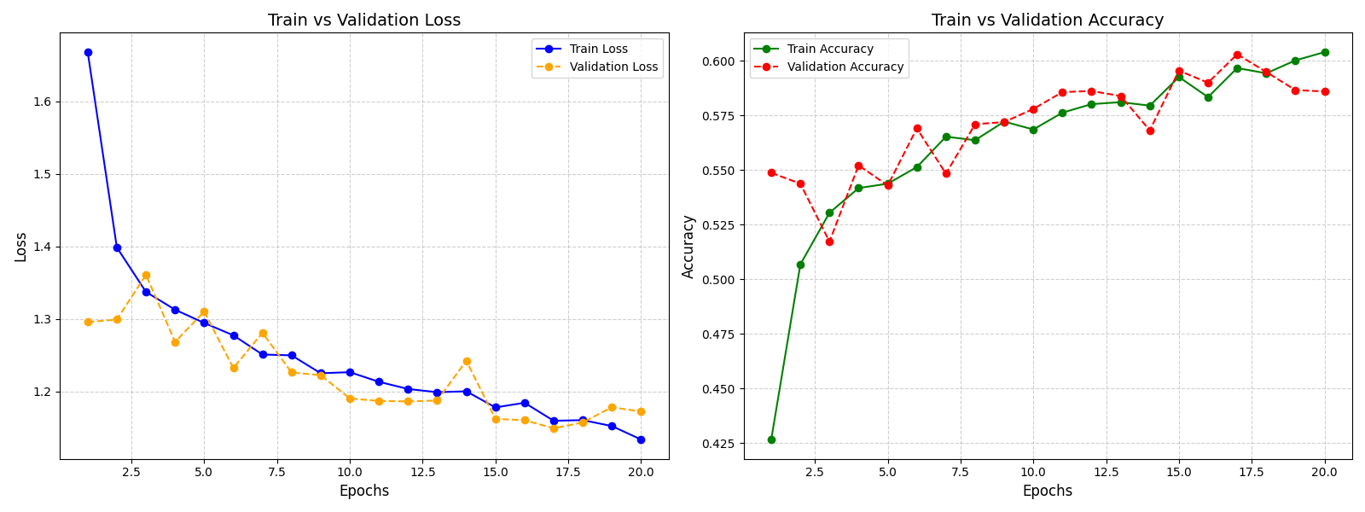
I-JEPA Pretrained w/ Frozen Encoder

Slide 19
VGG16 - Results
Experiment | Training Acc | Validation Acc | Training Loss | Validation Loss
Random Init | 38.33% | 39.64% | 1.60 | 1.62
Imagenet | 98.48% | 85.87% | 0.049 | 0.658
Imagenet + Frozen Encoder | 53.08% | 55.15% | 1.33 | 1.26
IJEPA | 81.80% | 80.16% | 0.55 | 0.58
IJEPA + Frozen Encoder | 60.39% | 58.59% | 1.13 | 1.17

Slide 20
ResNet50
Encoder

Slide 21
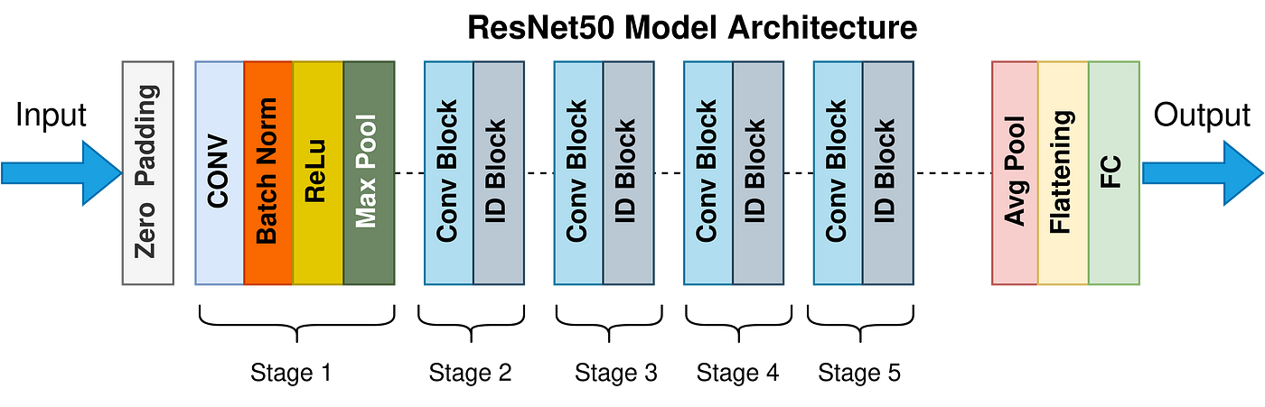
ResNet50 Architecture

Slide 22
Experiments
I-JEPA Pretrained with ResNet50, trainable weights and linear probing (classification)
I-JEPA Pretraining, frozen encoder and linear probing (classification)
I-JEPA Pretrained ResNet50, last residual block removed

Slide 23
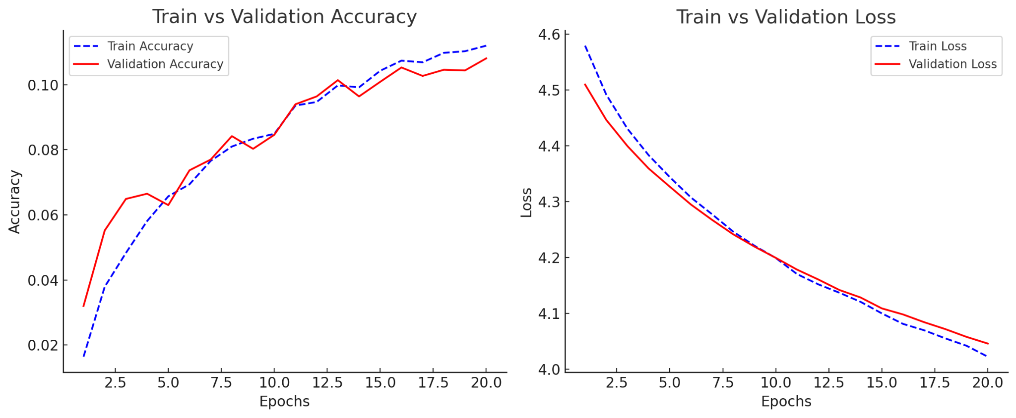
I-JEPA Pretrained with ResNet50 - Trainable weights

Slide 24
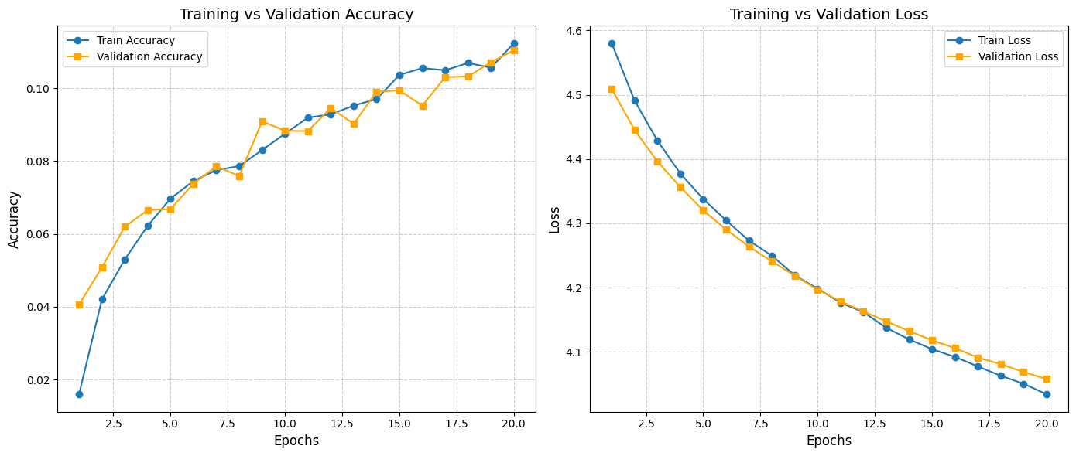
ResNet50 w/ Imagenet weights - Frozen Encoder

Slide 25
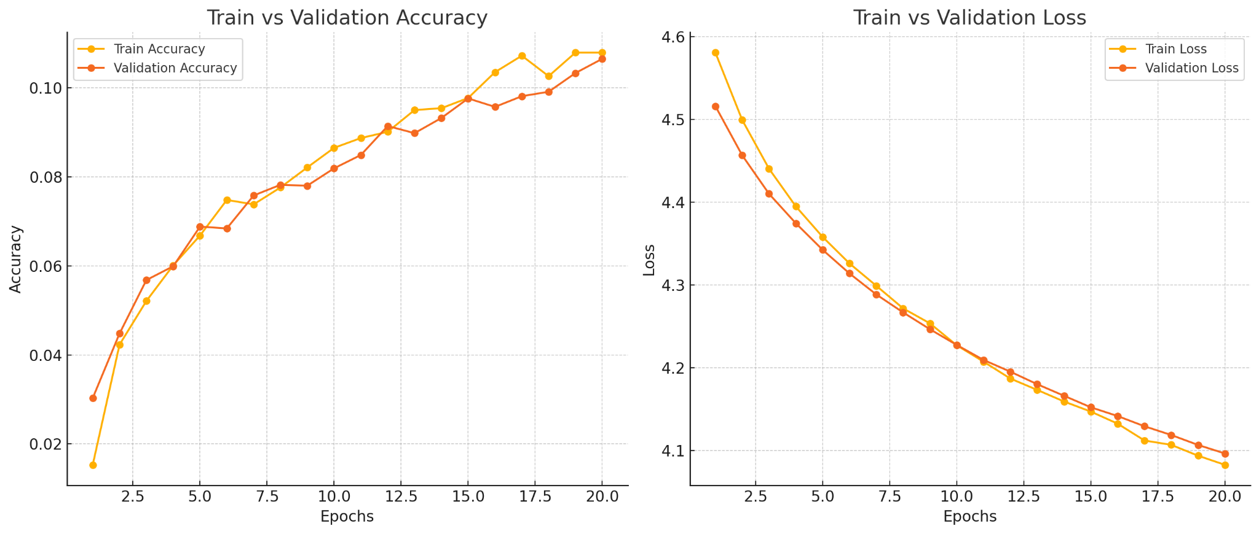
I-JEPA Pretrained w/o 32 layers (last residual block)

Slide 26
Experiment | Training Acc | Training Loss | Validation Acc | Validation Loss | Test Accuracy
IJEPA + Frozen Encoder | 11.23% | 4.034 | 11.04% | 4.0576 | 11.04%
Imagenet + Block 5 removed from ResNet | 10.79% | 4.0823 | 10.56% | 4.0962 | 10.65%
IJEPA + trainable weights | 11.20% | 4.022 | 10.81% | 4.0463 | 10.81%

Slide 27
MobileNetV2
Encoder

Slide 28
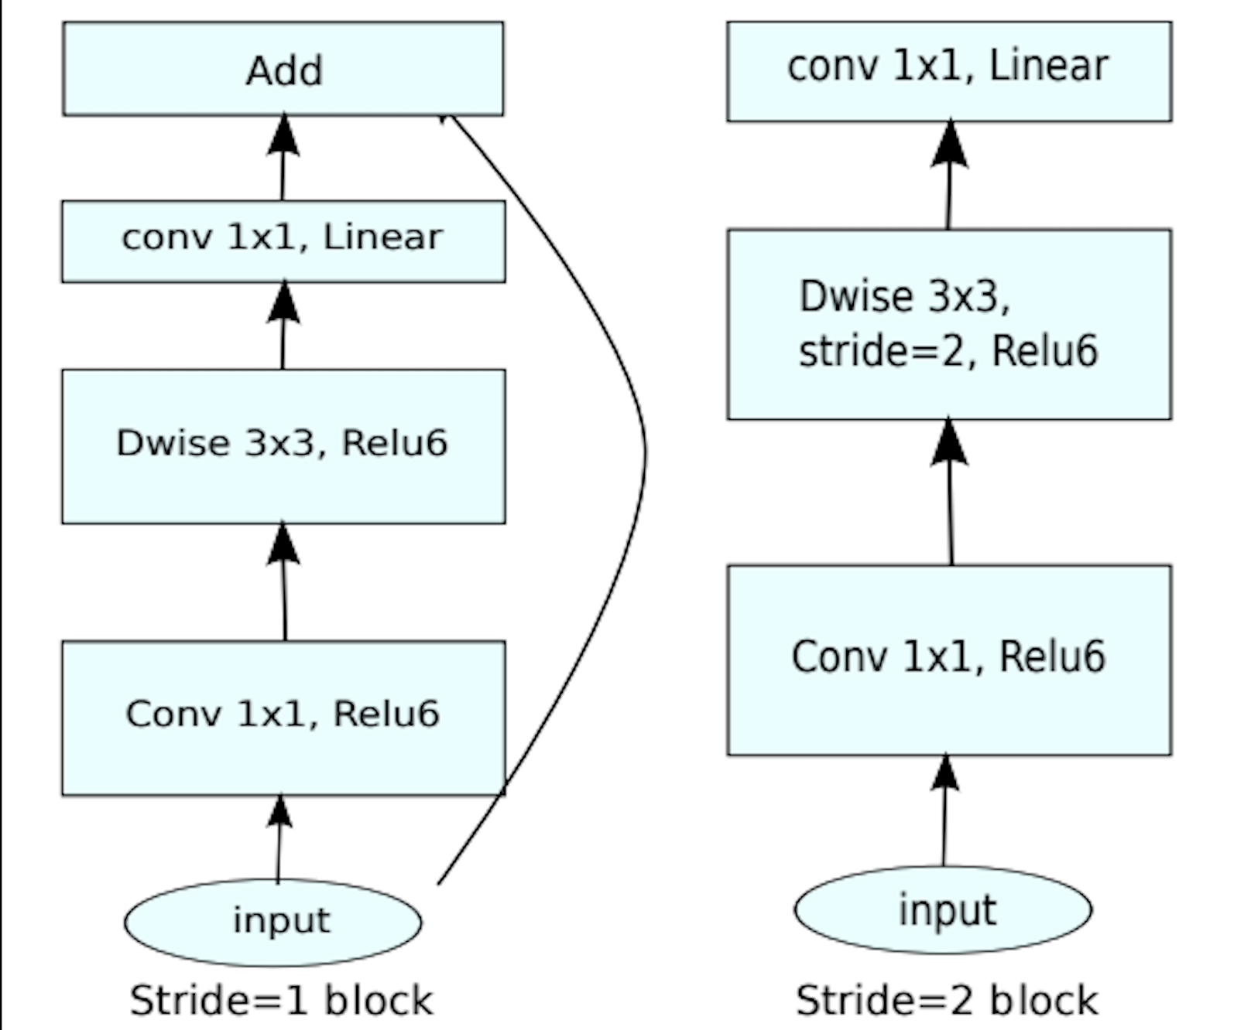
MobileNetV2 architecture

Slide 29
Experiments
MobileNetV2 with random weights initialized(Without Imagenet weights)
MobileNetV2 with ImageNet weights
MobileNetV2 using IJEPA with random weights initialized(Without Imagenet weights)
MobileNetV2 using IJEPA with ImageNet weights

Slide 30
MobileNetV2 with random weights initialized(Without Imagenet weights) - Results for Classifying cifar-10
Best Validation Accuracy: 76.56%
MobileNetV2 without imagenet weights
Cifar-10 dataset

Slide 31
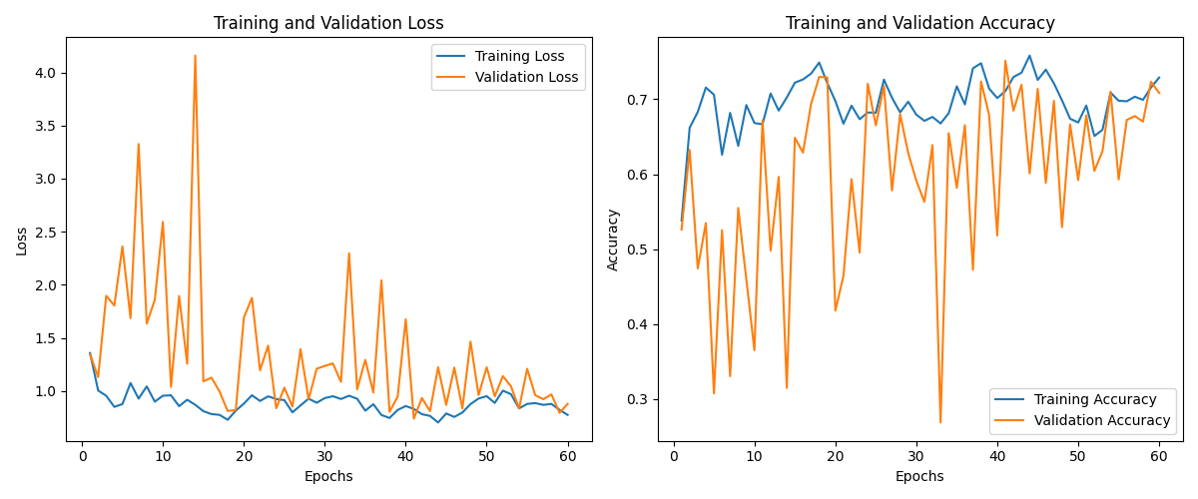
MobileNetV2 with ImageNet weights -Results for Classifying cifar-10
Best Validation Accuracy: 82.20%

Slide 32
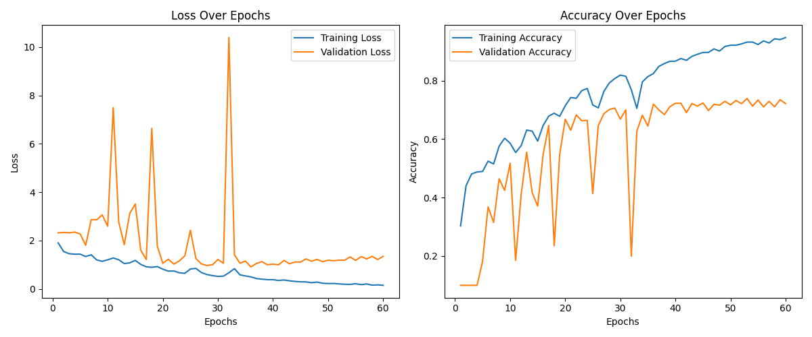
IJEPA-MobileNetV2 with random weights initialized(Without Imagenet weights) - Results for Classifying cifar-10
Best Validation Accuracy: 73.92%

Slide 33
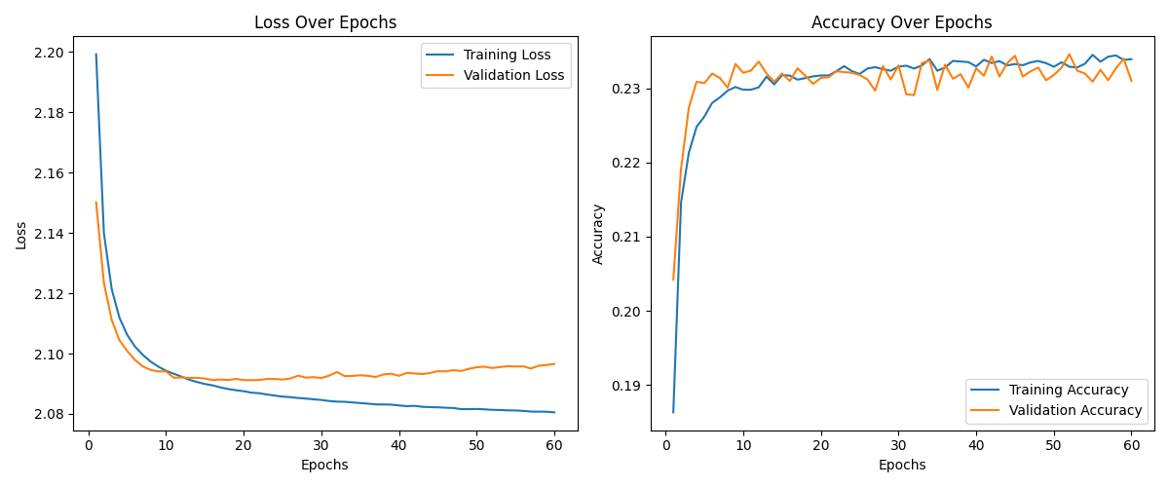
IJEPA-MobileNetV2 with ImageNet weights- Results for Classifying cifar-10
Best Validation Accuracy: 76.52%

Slide 34
MobileNetV2 - Results
Experiment | Best Validation Loss
With random weights initialized(Without Imagenet weights) | 76.56%
With ImageNet weights | 82.20%
IJEPA + Without Imagenet weights | 73.92%
IJEPA + With Imagenet weights | 76.52%
*Number of Epochs Trained: 60

Slide 35
AlexNet
EfficientNet
Encoder

Slide 36
Experiments
Random weights initialized(Without Imagenet weights)
Model with ImageNet weights
Model using IJEPA Encoder with random weights initialized(Without Imagenet weights)
Model using IJEPA Encoder with ImageNet weights

Slide 37
Convergence on Cifar 10 Classification Task
Model | Without IJEPA Random Weights Initialized | Without IJEPA Imagenet Weights | IJEPA Encoder trained with Random Weights | IJEPA Encoder Finetuned Imagenet Weights
AlexNet | Epochs 50 Accuracy 76.13 | Epochs 35 Accuracy 69.53 | Epochs 10 Accuracy 24.28 | Epochs 10 Accuracy 62.49
EfficientNetB2 | Epochs 35 Accuracy 69.13 | Epochs 25 Accuracy 58.13 | Epochs 10 Accuracy 58.49 | Epochs 10 Accuracy 68.36

Slide 38
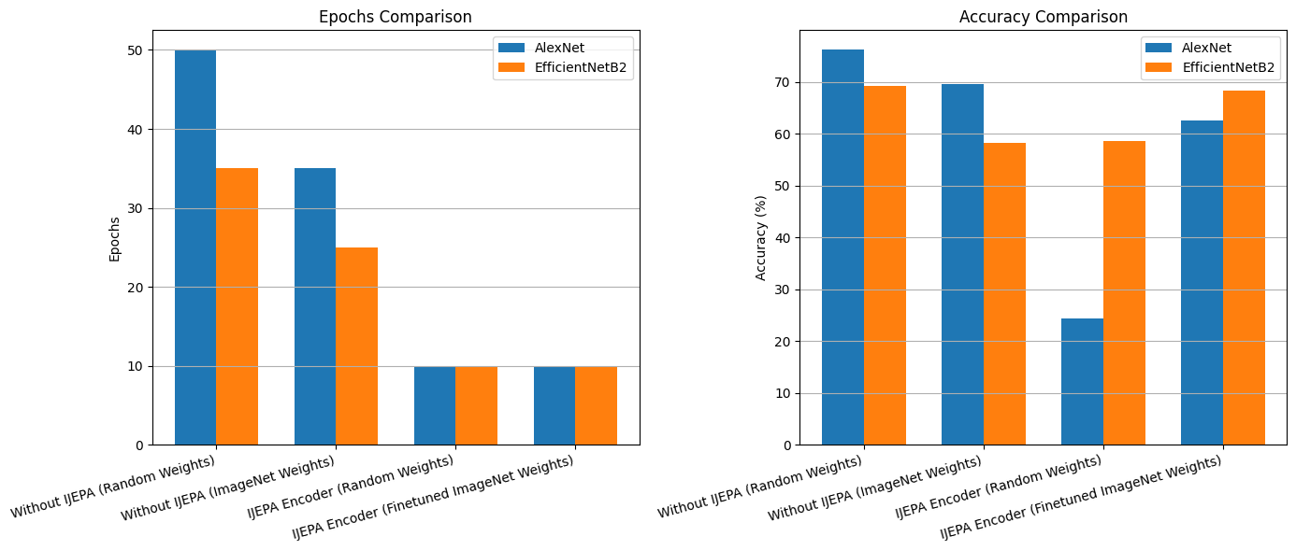
Convergence on Cifar 10 Classification Task

Slide 39
Conclusion
Faster Convergence with IJEPA: Models utilizing IJEPA Encoder converge significantly faster, requiring fewer epochs while maintaining competitive accuracy.
Balance of Efficiency and Performance: Incorporating IJEPA with finetuned weights offers an optimal trade-off between training efficiency and accuracy.

Slide 40
Thank You

